Slide 1

Building Multi-Agent Apps on top of Azure PostgreSQL
Mehrsa Golestaneh
Arnaud Comet
In partnership with

Slide 2
Agenda
Introduction to Multi-AI Agent and Database
Autogen 0.4 versus 0.2
Orchestration Types with Autogen
Demo
Questions?

Slide 3
Why Multi-AI Agents?
Specialization and Expertise
Parallel Processing
Redundancy and Reliability
Adaptive Collaboration
Security & Risk Mitigation
Notes:
Specialization and Expertise: Having multiple AI agents allows each one to specialize in specific tasks or domains. This means each agent can be optimized for its particular role (e.g., natural language understanding, data analysis, knowledge retrieval), leading to higher overall performance than a single agent trying to do everything.
Parallel Processing: Multiple agents can operate simultaneously on different parts of a complex problem. This parallelization can significantly speed up problem-solving and reduce bottlenecks, which is especially valuable for time-sensitive tasks or large-scale data processing.
Redundancy and Reliability: When several agents collaborate, they can cross-check each other’s outputs. This redundancy helps catch errors or inconsistencies, leading to more robust and reliable results. If one agent struggles with a task, another specialized agent might handle it more accurately.
Adaptive Collaboration: Multi-agent setups can dynamically adapt to new information or changing goals by reassigning tasks to whichever agent is best equipped for them. This flexible coordination makes the system more resilient and capable of handling complex workflows compared to a single, fixed-purpose AI model.
Security and risk mitigation: Models can be applied to control who has access to what instead of giving global access to one agent. In a multi-agent setup, specialized “guardian” or “monitor” agents can be deployed to oversee the activities of other agents and detect anomalies or suspicious behaviors. This additional layer of oversight provides greater resilience against security threats, as multiple agents cross-verify each other’s actions.

Slide 4
Autogen 0.4 vs. 0.2
Feature / Aspect | AutoGen v0.4+
Agents | More flexibility in handling agents, including creating custom agents, multi-modal input support, easy saving of states, etc. Specialized preset agents such as CodeExecuter
Agent Orchestration | Enhanced coordination, allowing agents to negotiate and reassign tasks dynamically. Much better closing of a loop. MagenticOne Nested chats
Messaging and Subscription | Broader messaging model, allowing agents to subscribe to specific “topics” or direct messages.
Memory & Context Management | Advanced context handling, including long-term memory modules for extended dialogs.
Monitoring | Emphasizes logs, traces, and debugging hooks, to see how messages flow between agents. This helps untangle complex multi-agent interactions.
Plug-Ins & Integrations | Extended plugin ecosystem with official and community-driven integrations.

Slide 5
Operational database scenarios with AI Agents
Which Products are in Transit?
Give me information about Alice Johnson
Chat with your Data
Write a Stored Procedure to Delete a Shipment
Database Development
Add a customer
Send a shipment to that customer of 2 laptops and 1 smartphone
Act on your Data

Slide 6
Orchestration Type – When to use What
RoundRobin:
agents take turn in order until task is completed.
Good for simple tasks – it is the fastest
May take multiple rounds for harder tasks or may need user help
Selector:
A planner agent selects the next speaker based on shared context and prompt instructions
A selector function can be used to enforce more control on choosing the next speaker
Good for usecases that require more controlled guidelines (extra planner agent and costs more prompt tokens)
MagenticOne:
Can handle complex tasks
Minimum need for "handholding"
Can be prone to "overthinking" so may not be an efficient choice for simpler use-cases
Provides clear explanations on reasoning behind its planning

Slide 7
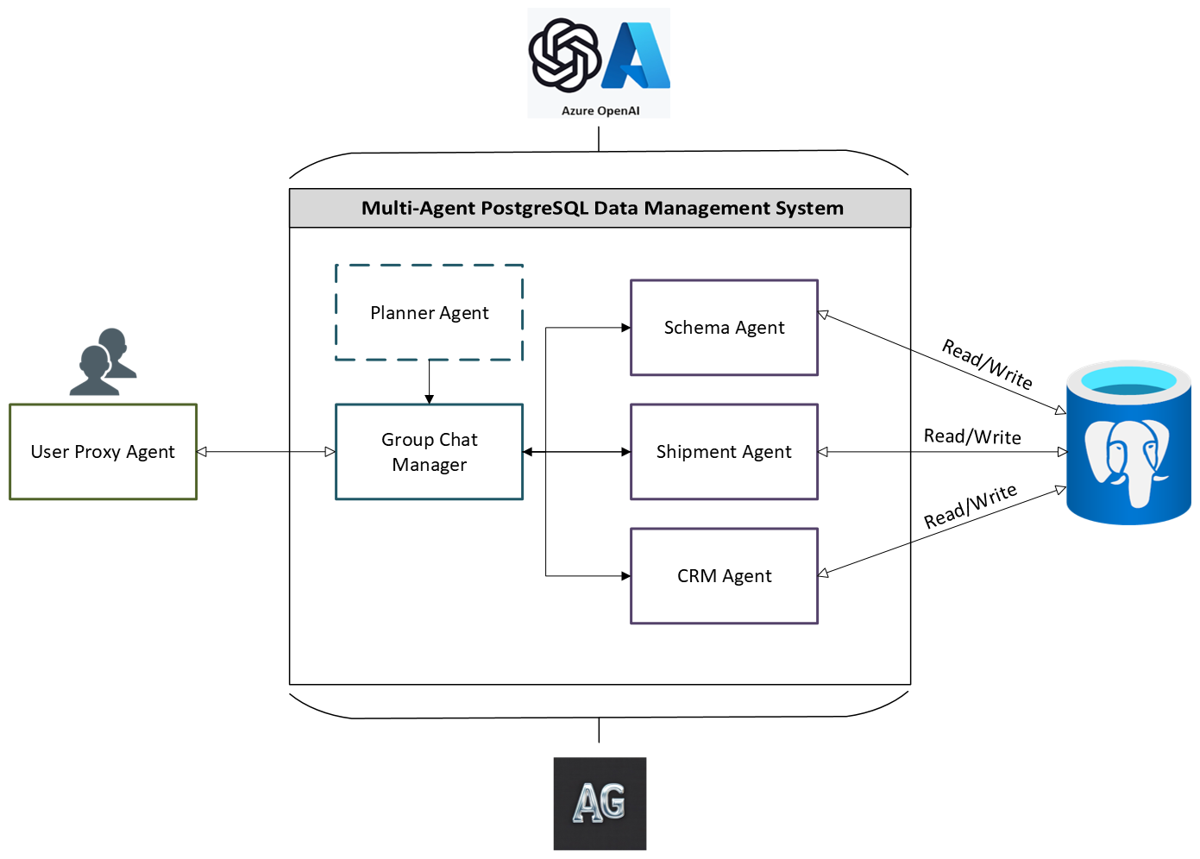
Example: A shipment Company

Slide 8
Demo
GitHub repo:
https://aka.ms/AAvpsxd

Slide 9
Questions?

Slide 10
Next steps
Star our Github Repo! @ Aka.ms
Got questions? post in GitHub forum or attend Discord Office Hours.
Join the community @ aka.ms/agentshack/discord
Attend more live expert sessions! aka.ms/agentshack/streams
Submit your project before April 30th 11:59 PM PT to win prizes! 💵
Notes:
Josh: Hi everyone, hope you enjoyed today's session! If you aren't registered for the AI Agents hackathon yet, register now at aka.ms/agentshack and start hacking on the agent of your dreams.
Pamela: If you have any questions along the way, post in our discussion forum or attend live office hours in Discord. And of course, make sure to join our upcoming live streams to keep learning about agents.
Josh: Once your project is ready, submit it before April 30th at 11:59PM PT to be eligible for our prizes. Thanks for joining!

Slide 11
Presentation guidelines

Slide 12
Overall presentation guidelines
Code and demos are encouraged!
Large font size (24pt for slides, 125% zoom for IDE)
Light mode is preferred for both slides and IDE, for accessibility reasons
Use our slide template if you're making a new presentation: https://aka.ms/agentshack/template
If you're using an old deck, please remove old event titles
We will record an intro and outro to autoplay for all sessions, so you do not need to include overall info about the hackathon itself

Slide 13
Sharing presentations and resources
Make an aka.ms link for any URL you want shared in the live chat. That includes any URLs that are in your slides, the slides themselves, and code samples.
Prepare a list of all URLs to share with Reactor host at start of stream. That way, the Reactor host can share those in the chat. *Only* channel moderators have permission to share URLs!
Share your slides! Either:
Uploaded exported PDF to SpeakerDeck before presenting
Uploaded PPTX to your personal Microsoft account and generate a link where "everyone can view"
Upload PPTX or PDF to our github repository (as long as it's under git file size limits)

Slide 14
Got code samples?
We are looking for code samples for the landing page that are ideally:
Easily deployable (azd or otherwise)
Compatible with GitHub Models (for free experimentation)
Use the free tier of Azure services
Are newbie-friendly
Ping me your code sample if you think it meets most/all of the criteria. Thanks!

Slide 15
Streamyard tips

Slide 16
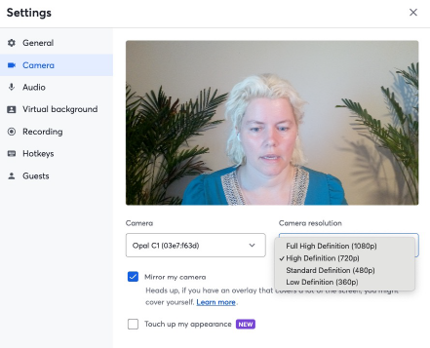
Streamyard: Camera
In Streamyard Camera settings:
Select the correct camera
Select "High Definition" resolution ("Full HD" is not necessary)
If you need a great camera,
consider your phone and a holder.

Slide 17
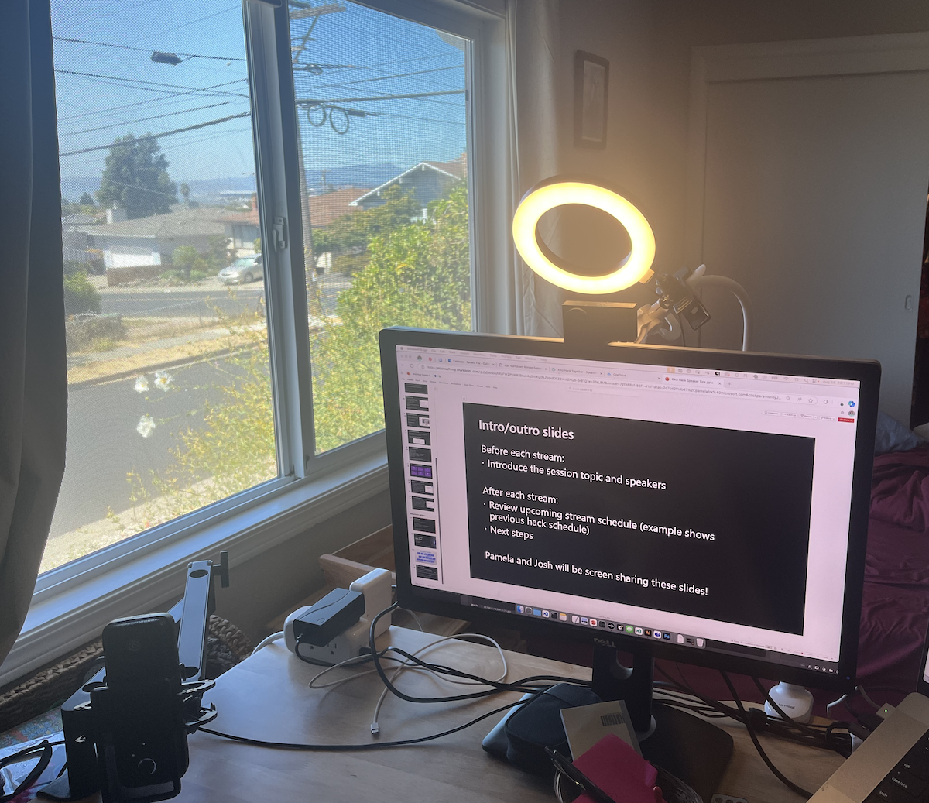
Lighting tips
Best lighting is natural light, diffused, directed towards your face
You may also benefit from a ring light (or lamp) behind camera
Don't be silhouetted (in front of a window/light source)

Slide 18
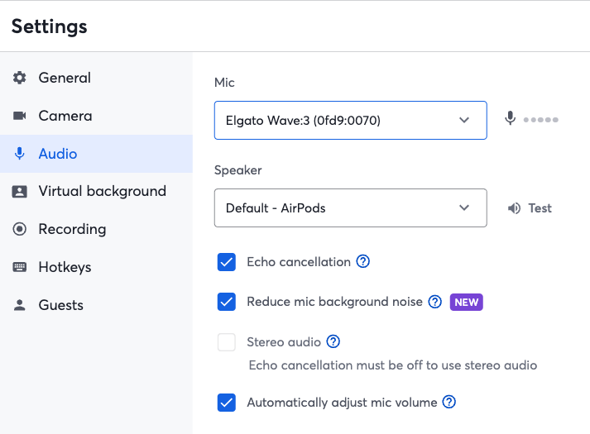
Streamyard: Audio
In Streamyard Audio settings:
Pick the correct Mic and Speaker
Check "Echo cancellation"
Check "Reduce mic background noise"
Let others in household know about your stream.
Ideally, you're in a sound-isolated environment.
If you need a good mic:
Elgato Wave:3 + arm + pop filter

Slide 19
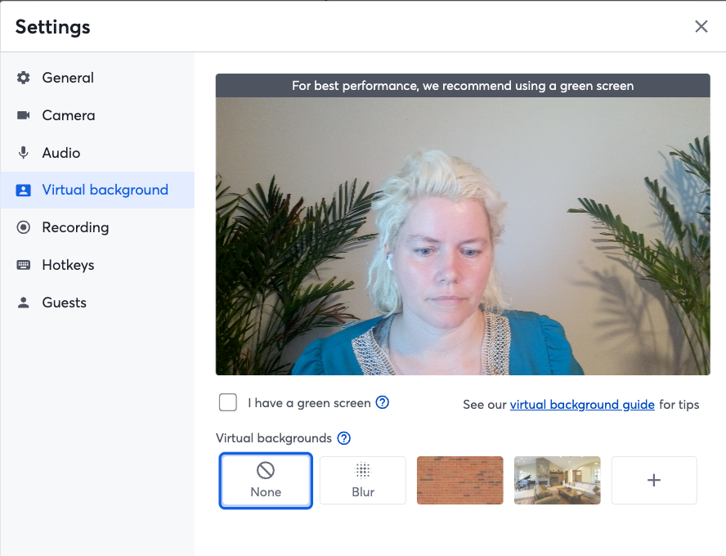
Streamyard: Background
If possible, do not use a virtual background, as they edges around your outline can be distracting.
If you do use a virtual background, either:
Use it with a green screen.
Tidy up behind you, then use your webcam to take a screenshot (without you in it), then use that as your virtual background. The edge effect isn't as noticeable as it's your actual background anyway and it means you don't have to keep it tidy!

Slide 20
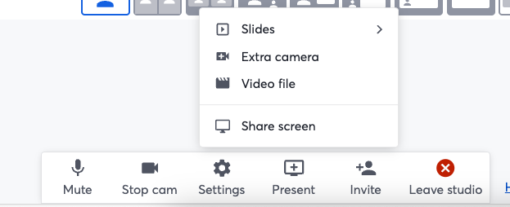
Streamyard: Screen sharing
From the Present button, you can either share a single application window or an entire screen.
If you are presenting entirely inside the same application (all browser, all PPT, all IDE, etc), then you can share a single application window.
If you have multiple presenters, then one of you could share the PPT while the other shares their IDE, and you can use verbal cues to ask Reactor host to switch.
Don't use this option if you need to switch between multiple apps yourself!

Slide 21
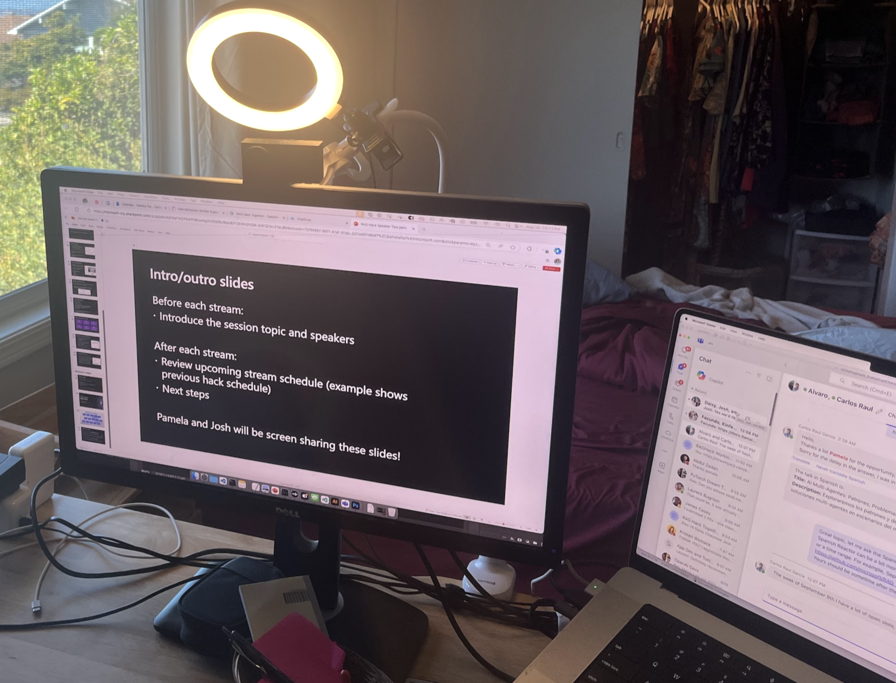
Streamyard: Screen sharing with Monitor/Laptop
You can share an entire screen and move Streamyard into a second screen.
You will spend most of time staring at your main screen (hopefully close to eye level with camera) and occasionally look over at Streamyard chat.

Slide 22
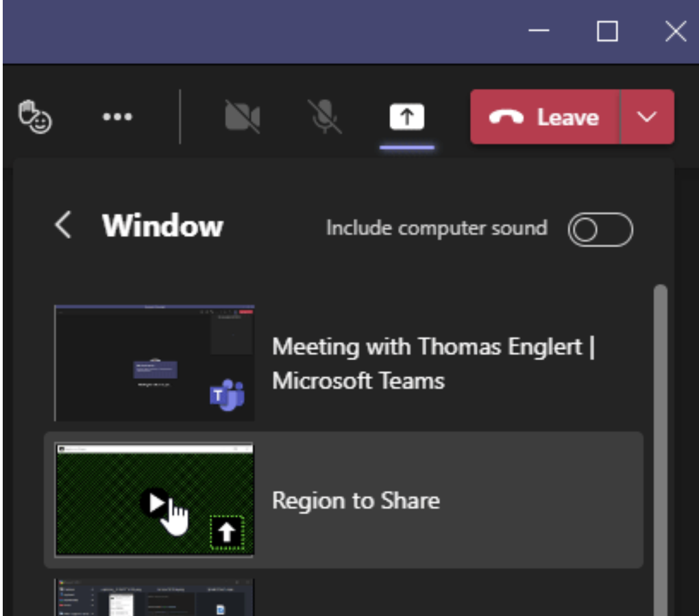
Streamyard: Screen sharing in Windows
Consider using https://github.com/tom-englert/RegionToShare
Create a 1920x1080 "window" on your monitor and share that
Move apps/browsers/etc. into the RegionToShare zone to share them
Consider combining with Fancy Zones in PowerToys to "snap" to the zone
Tutorial: Share Partial Screen in Zoom, Microsoft Teams, Google Meet, & More - YouTube

Slide 23
Screen sharing privacy tips
What to turn off/hide:
Microsoft Teams
iMessages (on Mac)
Docker Desktop (if unneeded – energy hog)
Any files (.env) or apps with passwords
YouTube personal recommendations
Use these tools to help:
Azure Mask Browser Extension to hide sub IDs
Public version of Azure Portal
Unhook extension for YouTube

Slide 24
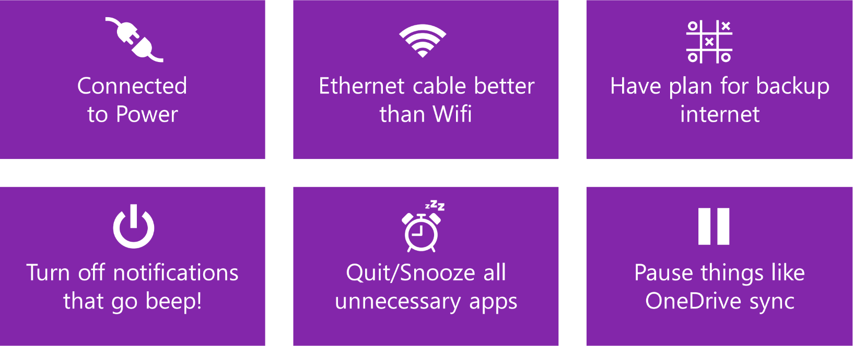
Optimize laptop for virtual talk

Slide 25
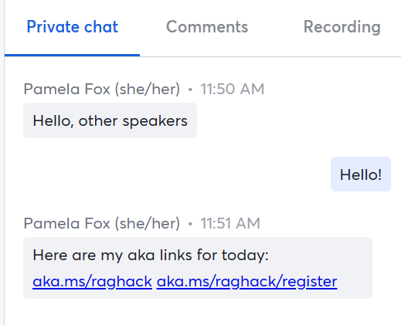
Streamyard: Private Chat
Only hosts and speakers see this tab
Share aka URLs here at the start of stream
You can ask hosts to highlight a question or post additional links throughout stream
Don't get too chatty in this tab, as it's distracting for whoever is presenting
Keep an eye on this tab, especially if you're a sole presenter or the question-raiser

Slide 26
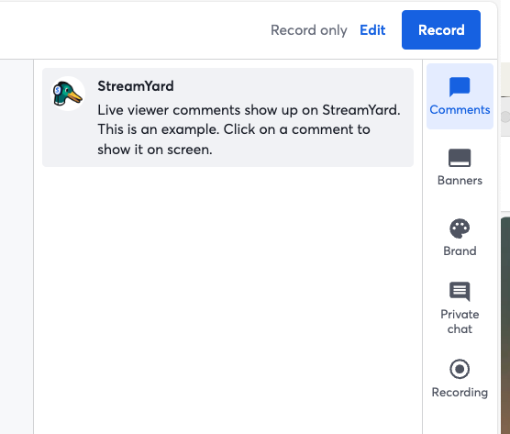
Streamyard: Comments/Questions
Comments and questions from attendees (YouTube/Twitch) will show up in Comments tab
We recommend having two people on the stage, one presents while the other one answers questions and raises questions to presenter
To reply directly in Streamyard, you must login with YouTube or Twitch
Only hosts can share links (not speakers)

Slide 27
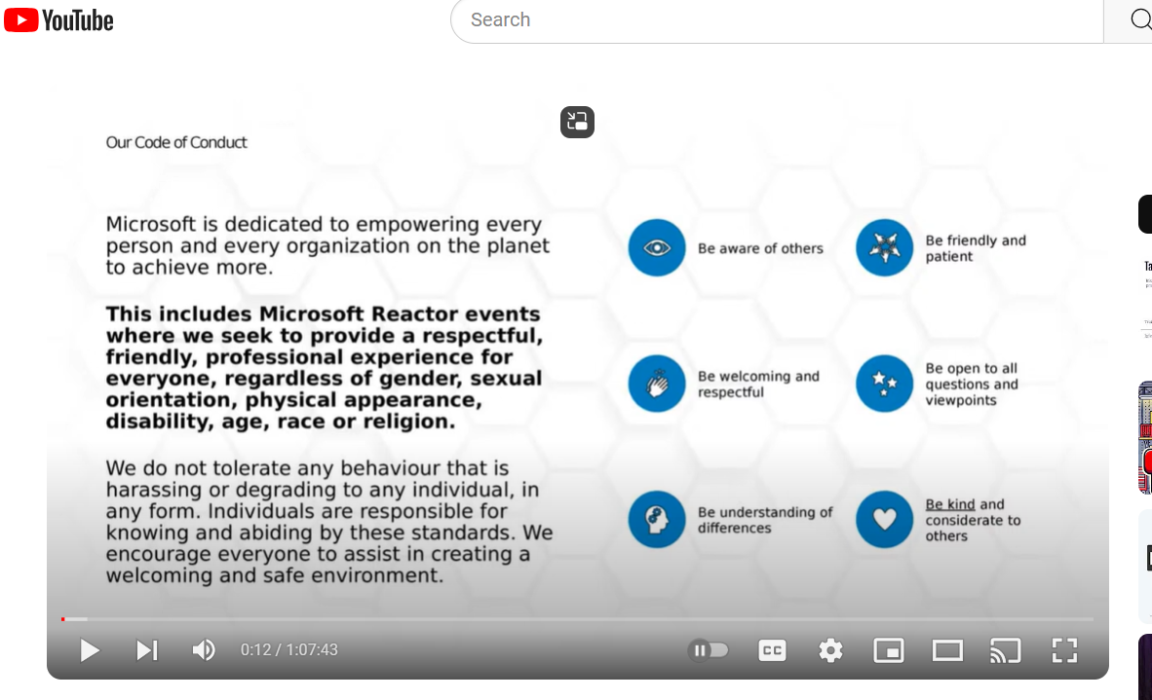
Livestream Run of Show
15 minutes before:
Join the streamyard
Check your camera and audio settings
Share your screen (and keep it shared)
Post all your links in the private chat
Go through slides with host and tell them when any switches need to happen (like to switch between co-speakers)
Start: Hackathon Intro slides will play (1 min)
Reactor Code of Conduct will play (1 min) →
All you!!
End: Hackathon Outro slides will play (1 min)
🛑 Never mute yourself, ever!

Slide 28
Intro slides
These will be prerecorded and played before each session

Slide 29
AI Agents Hackathon
April 8 - 30
Build, innovate and #HackTogether
aka.ms/agentshack
In partnership with
Notes:
Welcome to the AI Agents hackathon live streams!
The AI Agents hack is a free virtual event running from April 8-30.

Slide 30
AI Agents Hackathon
aka.ms/AgentsHack
7
MONDAY
8
TUESDAY
9
WEDNESDAY
10
THURSDAY
11
FRIDAY
12
SATURDAY
13
SUNDAY
Week 1
Kickoff
Guiness record!
Azure AI Agent
Java Agents
M 365 Copilots
Semantic Kernel
.NET Agents
Hack!
Hack!
Hack!
14
MONDAY
15
TUESDAY
16
WEDNESDAY
17
THURSDAY
18
FRIDAY
19
SATURDAY
20
SUNDAY
Hack!
JS Agents
AutoGen
.NET Agents
Cosmos DB
Copilot Studio
Azure AI Models
Code Interpreters
Langchain4J
Agentic Voice
Hack!
Hack!
Hack!
Week 1
21
MONDAY
22
TUESDAY
23
WEDNESDAY
24
THURSDAY
25
FRIDAY
26
SATURDAY
27
SUNDAY
Week 1
Llamaindex.TS
Prompty
Azure SQL
SignalR + SK
PostgreSQL
Agentic RAG
Multi-DB Agents
Azure Functions
Real-time ACS
Robotic agents
Hack!
Hack!
Hack!
28
MONDAY
29
TUESDAY
30
WEDNESDAY
We will also hold Discord office hours throughout the week.
Join the Azure AI Community on Discord here:
aka.ms/agentshack/discord
Week 1
Hack!
Responsible AI
Securing Agents
Evaluation
HACKS DUE!
11:59 PM PT
Notes:
We’re hosting over 20 live streams where you’ll learn how to build agents using various Microsoft technologies. At the end of the three weeks, submit your project for a chance to win fantastic prizes!
Now, let’s hear from our friends at Reactor...

Slide 31
Outro slides
These will be prerecorded and played before each session

Slide 32
AI Agents Hackathon: Next steps
Register for the hackathon @ aka.ms/agentshack/register
Got questions? post in GitHub forum or attend Discord Office Hours.
Join the community @ aka.ms/agentshack/discord
Attend more live expert sessions! aka.ms/agentshack/streams
Submit your project before April 30th 11:59 PM PT to win prizes! 💵
Notes:
Josh: Hi everyone, hope you enjoyed today's session! If you aren't registered for the AI Agents hackathon yet, register now at aka.ms/agentshack and start hacking on the agent of your dreams.
Pamela: If you have any questions along the way, post in our discussion forum or attend live office hours in Discord. And of course, make sure to join our upcoming live streams to keep learning about agents.
Josh: Once your project is ready, submit it before April 30th at 11:59PM PT to be eligible for our prizes. Thanks for joining!

